Slide 1
Combinational Logic with
MSI & LSI

Slide 2
MSI & LSI Components in Combinational Logic
SSI – Small Scale Integration
No. of gates – up to 10. For example: IC7400, IC7404 ,etc
MSI – Medium Scale Integration
No. of gates – 10-100. For example: MUX, DEMUX, Encoder, etc
LSI – Large Scale Integration
No. of gates – 100-1000. For example: ROM,PLA, etc
VLSI – Very Large Scale Integration
No. of gates – more than 1000. For example: Microprocessor

Slide 3
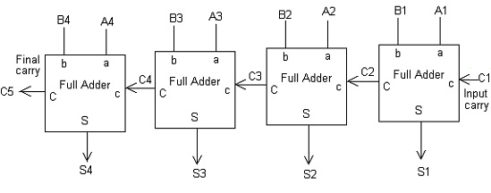
4-bit Binary Parallel Adder
Parallel Adder is a digital circuit capable of finding the arithmetic sum of two binary numbers that is greater than one bit in length by operating on corresponding pairs of bits in parallel.
=0

Slide 4
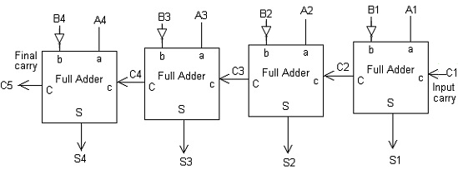
4-bit Binary Parallel Subtractor
A Parallel Subtractor is a digital circuit capable of finding the arithmetic difference of two binary numbers that is greater than one bit in length by operating on corresponding pairs of bits in parallel.
=1

Slide 5
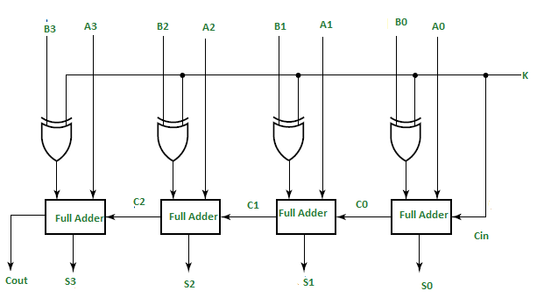
4-bit Binary Parallel Adder/Subtractor
A Binary Adder-Subtractor is circuit which is capable of both addition and subtraction of binary numbers in one circuit itself.
X-OR Gate
A | B | F
0 | 0 | 0
0 | 1 | 1
1 | 0 | 1
1 | 1 | 0
The above circuit works as adder when k=0 and subtractor when k=1

Slide 6
BCD adder (sum up to 9)
BCD Adder
Dec
0 | 0 | 0 | 0 | 0 | 0
1 | 0 | 0 | 0 | 0 | 1
2 | 0 | 0 | 0 | 1 | 0
3 | 0 | 0 | 0 | 1 | 1
4 | 0 | 0 | 1 | 0 | 0
5 | 0 | 0 | 1 | 0 | 1
6 | 0 | 0 | 1 | 1 | 0
7 | 0 | 0 | 1 | 1 | 1
8 | 0 | 1 | 0 | 0 | 0
9 | 0 | 1 | 0 | 0 | 1

Slide 7
BCD adder (sum is 10 to 19)
BCD Adder
10 | 1 | 0 | 0 | 0 | 0
11 | 1 | 0 | 0 | 0 | 1
12 | 1 | 0 | 0 | 1 | 0
13 | 1 | 0 | 0 | 1 | 1
14 | 1 | 0 | 1 | 0 | 0
15 | 1 | 0 | 1 | 0 | 1
16 | 1 | 0 | 1 | 1 | 0
17 | 1 | 0 | 1 | 1 | 1
18 | 1 | 1 | 0 | 0 | 0
19 | 1 | 1 | 0 | 0 | 1

Slide 8
Algorithm for BCD adder
BCD Adder
If sum is up to 9
Use the regular Adder.
If the sum > 9
Use the regular adder and add 6 to the result

Slide 9
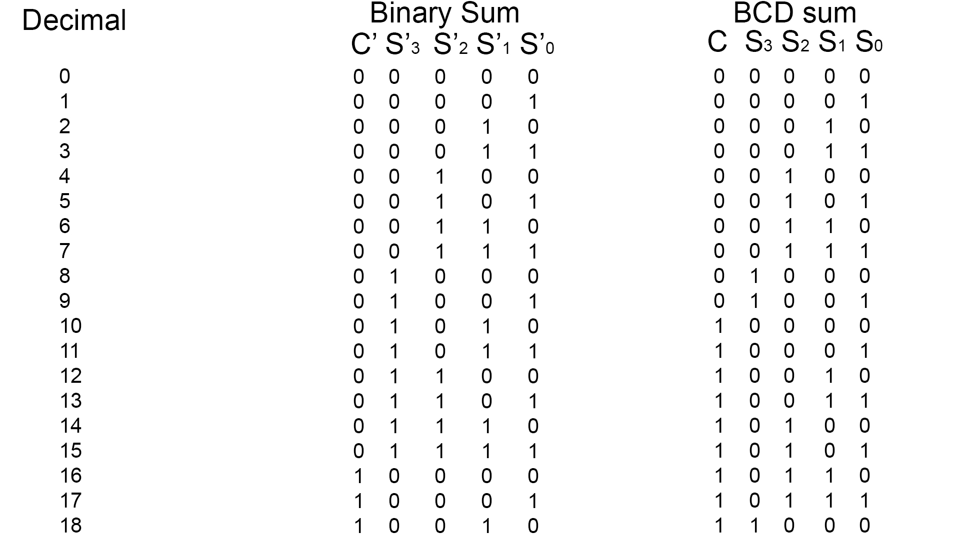
BCD Adder

Slide 10
BCD Adder
Dec |  | C’ | S3’ | S2’ | S1’ | S0’ |  | C | S3 | S2 | S1 | S0
10 |  | 0 | 1 | 0 | 1 | 0 |  | 1 | 0 | 0 | 0 | 0
11 |  | 0 | 1 | 0 | 1 | 1 |  | 1 | 0 | 0 | 0 | 1
12 |  | 0 | 1 | 1 | 0 | 0 |  | 1 | 0 | 0 | 1 | 0
13 |  | 0 | 1 | 1 | 0 | 1 |  | 1 | 0 | 0 | 1 | 1
14 |  | 0 | 1 | 1 | 1 | 0 |  | 1 | 0 | 1 | 0 | 0
15 |  | 0 | 1 | 1 | 1 | 1 |  | 1 | 0 | 1 | 0 | 1
16 |  | 1 | 0 | 0 | 0 | 0 |  | 1 | 0 | 1 | 1 | 0
17 |  | 1 | 0 | 0 | 0 | 1 |  | 1 | 0 | 1 | 1 | 1
18 |  | 1 | 0 | 0 | 1 | 0 |  | 1 | 1 | 0 | 0 | 0
Add ‘0110’ if : C’=1
S3’ .S1’ = 1
S3’.(s2’ + s1’) =1
C’ + s3’.s1’+s3’(s2’+s1’)
= C’ + s3’.s1’+ s3’.s2’ + s3’.s1’
= C’ + s3’.s1’+ s3’.s2
If [C’ + s3’.s1’+ s3’.s2] = 1; add ‘0110’

Slide 11
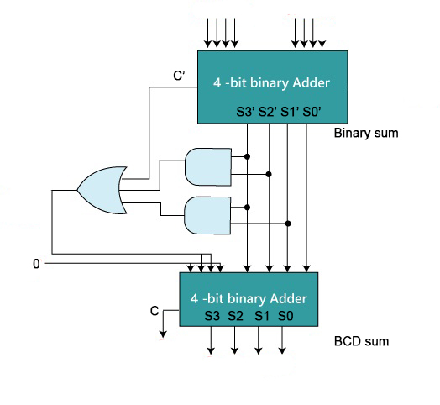
BCD Adder

Slide 12
Magnitude Comparator
A magnitude comparator is a hardware electronic device that takes two numbers as input in binary form and determines whether one number
is greater than,
less than or
equal to the other number.
It has three output terminals, one each for equality
A = B A >B A <B

Slide 13
1-bit Magnitude Comparator
Inputs |  | Outputs
A | B | A>B | A=B | A<B
0 | 0 | 0 | 1 | 0
0 | 1 | 0 | 0 | 1
1 | 0 | 1 | 0 | 0
1 | 1 | 0 | 1 | 0

Slide 14
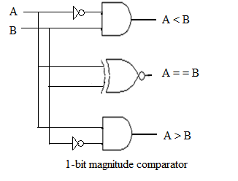
1-bit Magnitude Comparator

Slide 15
2-bit Magnitude Comparator
Inputs |  |  |  | Outputs
A |  | B
A1 | A0 | B1 | B0 | A>B | A=B | A<B
0 | 0 | 0 | 0 | 0 | 1 | 0
0 | 0 | 0 | 1 | 0 | 0 | 1
0 | 0 | 1 | 0 | 0 | 0 | 1
0 | 0 | 1 | 1 | 0 | 0 | 1
0 | 1 | 0 | 0 | 1 | 0 | 0
0 | 1 | 0 | 1 | 0 | 1 | 0
0 | 1 | 1 | 0 | 0 | 0 | 1
0 | 1 | 1 | 1 | 0 | 0 | 1
Inputs |  |  |  | Outputs
A |  | B
A1 | A0 | B1 | B0 | A>B | A=B | A<B
1 | 0 | 0 | 0 | 1 | 0 | 0
1 | 0 | 0 | 1 | 1 | 0 | 0
1 | 0 | 1 | 0 | 0 | 1 | 0
1 | 0 | 1 | 1 | 0 | 0 | 1
1 | 1 | 0 | 0 | 1 | 0 | 0
1 | 1 | 0 | 1 | 1 | 0 | 0
1 | 1 | 1 | 0 | 1 | 0 | 0
1 | 1 | 1 | 1 | 0 | 1 | 1

Slide 16
2-bit Magnitude Comparator

Slide 17
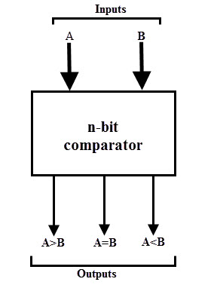
4-bit Magnitude Comparator
A → A3 A2 A1 A0
B → B3 B2 B1 B0
A → 1001
B → 0111
X-Nor Gate
A | B | F
0 | 0 | 1
0 | 1 | 0
1 | 0 | 0
1 | 1 | 1

Slide 18
4-bit Magnitude Comparator
F1 → A=B
A3=B3; A2=B2; A1=B1;A0=B0
i.e. A_{i}=B_{i}
Using X-Nor gate:
X_{i} = AB+A’B’ = (A’B+AB’)’
If F1 = x0.x1.x2.x3. = 1; A=B
F2 → A>B
A3>B3 [A3=1, B3=0]
A3=B3; A2>B2 [ A2=1, B2 = 0]
A3=B3; A2=B2; A1>B1 [ A1=1, B1 = 0]
A3=B3; A2=B2; A1=B1; A0>B0 [ A0=1, B0 = 0]
If F2 = A3.B3’+ x3.A2.B2’+ x3.x2.A1.B1’+ x3.x2.x1.A0.B0’ = 1; A>B

Slide 19
4-bit Magnitude Comparator
F3 → A<B
A3<B3 [A3=0, B3=1]
A3=B3; A2<B2 [ A2=0, B2 = 1]
A3=B3; A2=B2; A1<B1 [ A1=0, B1 = 1]
A3=B3; A2=B2; A1=B1; A0<B0 [ A0=0, B0 = 1]
If F2 = A3’.B3+ x3.A2’.B2+ x3.x2.A1’.B1+ x3.x2.x1.A0’.B0 = 1; A>B

Slide 20
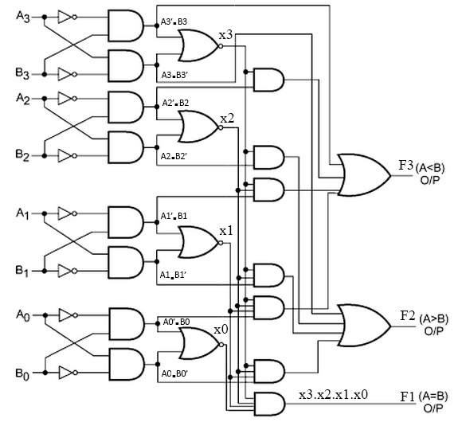
4-bit Magnitude Comparator

Slide 21
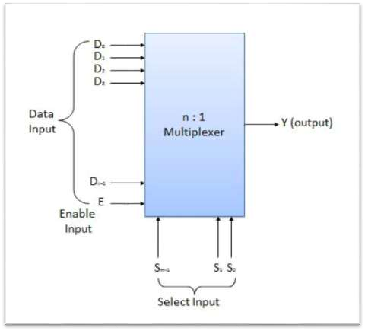
Multiplexer (MUX)
A Multiplexer is a digital circuit that has multiple inputs
and a single output.
The selection of one of the n inputs is done by the select inputs
It has one output selected at a time.
It is also known as Data Selector.
Size of MUX = 2^{n} x 1
where n is number of select inputs

Slide 22
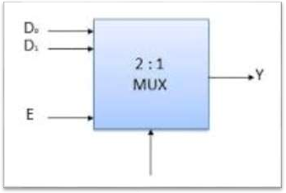
2:1 MUX
Number of Inputs = 2
Number of Output = 1 Size of MUX = 2¹x1
Select inputs = 1
BLOCK DIAGRAM
TRUTH TABLE
S | OUTPUT Y
0 | D₀
1 | D₁
Y = S’D₀ + SD₁

Slide 23
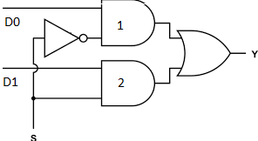
2:1 MUX
Y = S’D₀ + SD₁

Slide 24
4:1 MUX
Number of Inputs =4
Number of Output = 1 Size of MUX = 2² x 1
Select inputs = 2
BLOCK DIAGRAM
TRUTH TABLE
S1 | S0 | Y
0 | 0 | D0
0 | 1 | D1
1 | 0 | D2
1 | 1 | D3
D0
D1 D2 D3
MUX
Y
S1 S0
Y=S1’S0’D0+S1’S0D1+S1SO’D2+S1S0D3

Slide 25
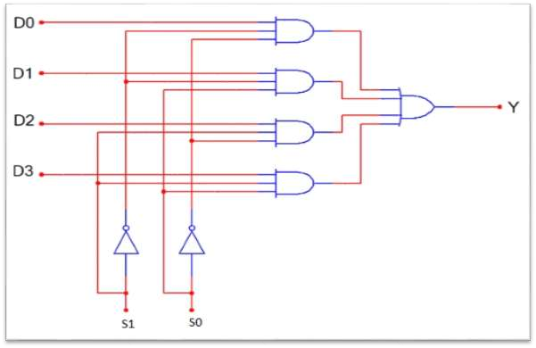
4:1 MUX
Y=S1’S0’D0+S1’S0D1+S1SO’D2+S1S0D3

Slide 26
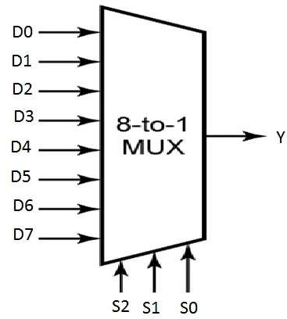
8:1 MUX
Number of Inputs =8
Number of Output = 1 Size of MUX = 2³ x 1
Select inputs = 3 Y= ?
BLOCK DIAGRAM
TRUTH TABLE
S2 | S1 | S0 | Y
0 | 0 | 0 | D0
0 | 0 | 1 | D1
0 | 1 | 0 | D2
0 | 1 | 1 | D3
1 | 0 | 0 | D4
1 | 0 | 1 | D5
1 | 1 | 0 | D6
1 | 1 | 1 | D7

Slide 27
Implementation of Boolean Function using MUX
Most important thing during this implementation is the implementation table which is derived from following rules:
List the inputs of the multiplexer and under them list all the minterms in two rows. The first row lists all those minterms where A is complemented, and the second row all the minterms with A uncomplemented, as shown in above example. Circle all the minterms of the function and inspect each column separately.
→ If the two minterms in a column are not circled, apply 0 to the corresponding multiplexer input.
→ If the two minterms are circled, apply 1 to the corresponding multiplexer input.
→ If the bottom minterm is circled and the top is not circled, apply A to the corresponding multiplexer input.
→ If the top minterm is circled and the bottom is not circled, apply A' to the corresponding multiplexer input

Slide 28
Implementation of Boolean Function using MUX
Implement the Boolean function F(A,B,C) = ∑(1,3,5,6) using MUX.
Number of inputs(n) = 3 (A,B,C)
Data input = 1; A
Select inputs =2 ; B and C [(n-1) is the no of select inputs]
Size of MUX = 2² x 1 = 4 x 1
Implementation table for input A to be connected,
 | I0 | I1 | I2 | I3
A’ | 0 | 1 | 2 | 3
A | 4 | 5 | 6 | 7
inputs | 0 | 1 | A | A’
0
I₀
1
I₁
4x1
MUX
A
Y
I₂
F
A’
I₃
S₁
S₀
B
C

Slide 29
Implementation of Boolean Function using MUX
Implement the Boolean function F(A,B,C) = ∑(1,3,5,6) using MUX.
Number of inputs(n) = 3 (A,B,C)
Data input = 1; B
Select inputs =2 ; A and C [(n-1) is the no of select inputs]
Size of MUX = 2² x 1 = 4 x 1
Implementation table for input B to be connected,
 | I0 | I1 | I2 | I3
B’ | 0 | 1 | 4 | 5
B | 2 | 3 | 6 | 7
inputs | 0 | 1 | B | B’
0
I₀
1
I₁
4x1
MUX
B
Y
I₂
F
B’
I₃
S₁
S₀
A
C

Slide 30
Implementation of Boolean Function using MUX
Implement the Boolean function F(A,B,C) = ∑(1,3,5,6) using MUX.
Number of inputs(n) = 3 (A,B,C)
Data input = 1; C
Select inputs =2 ; A and B [(n-1) is the no of select inputs]
Size of MUX = 2² x 1 = 4 x 1
Implementation table for input C to be connected,
 | I0 | I1 | I2 | I3
C’ | 0 | 2 | 4 | 6
C | 1 | 3 | 5 | 7
inputs | C | C | C | C’
C
I₀
C
I₁
4x1
MUX
C
Y
I₂
F
C’
I₃
S₁
S₀
A
B

Slide 31
Implementation of Boolean Function using MUX
Implement the Full adder circuit using MUX.
From the truth table of Full Adder
S(x,y,z)=∑(1,2,4,7)
C(x,y,z)=∑(3,5,6,7)
Number of inputs = 3 (x,y,z)
Data input = 1; x
Select inputs =2 ; y and z
Size of MUX = 2² x 1 = 4 x 1
Implementation table for input x to be connected, For sum
 | I0 | I1 | I2 | I3
x’ | 0 | 1 | 2 | 3
x | 4 | 5 | 6 | 7
inputs | x | x’ | x’ | x

Slide 32
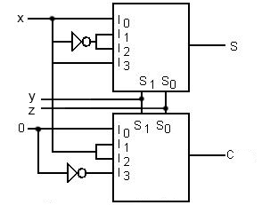
Implementation of Boolean Function using MUX
Implement the Full adder circuit using MUX.
Implementation table for input x to be connected, For carry
 | I0 | I1 | I2 | I3
x’ | 0 | 1 | 2 | 3
x | 4 | 5 | 6 | 7
inputs | 0 | x | x | 1

Slide 33
Implementation of Boolean Function using MUX
Implement the Boolean function F(A,B,C,D) = ∑(0,1,3,4,8,9,15) using MUX
Number of inputs = 4 (A,B,C,D)
Data input = 1; A
Select inputs =3 ; B,C and D
Size of MUX = 2³ x 1 = 8 x 1
Implementation table for input A to be connected,
 | I0 | I1 | I2 | I3 | I4 | I5 | I6 | I7
A’ | 0 | 1 | 2 | 3 | 4 | 5 | 6 | 7
A | 8 | 9 | 10 | 11 | 12 | 13 | 14 | 15
i/p | 1 | 1 | 0 | A’ | A’ | 0 | 0 | A

Slide 34
Implementation of Boolean Function using MUX
Implement the Boolean function F(A,B,C,D) = ∑(0,1,3,4,8,9,15) using MUX

Slide 35
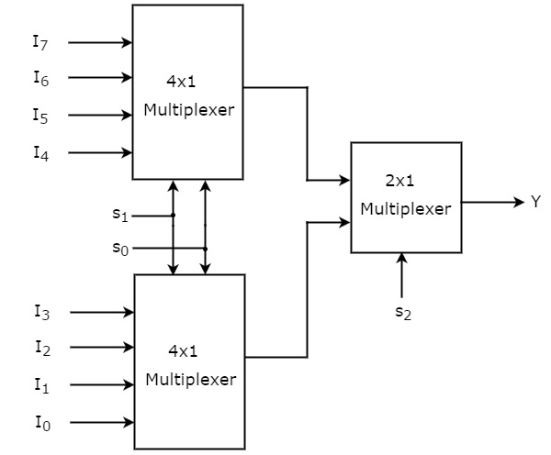
Multiplexer (MUX)
Design 8 x 1 MUX using 4 x 1 and 2 x 1 MUX.

Slide 36
Multiplexer (MUX)
Design 32 x 1 MUX using 16 x 1 and 2 x 1 MUX.
Design 16 x 1 MUX using 8 x 1 MUX.

Slide 37
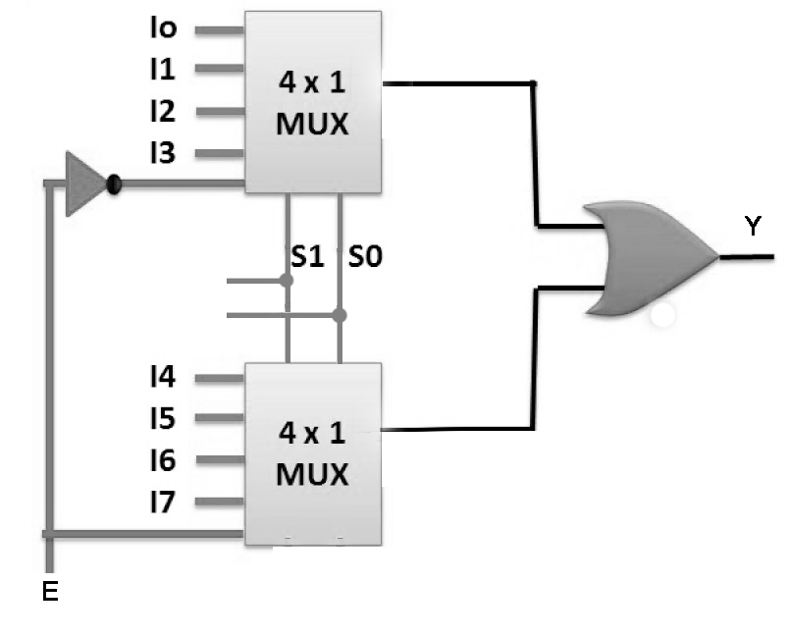
Multiplexer (MUX)
Design 8 x 1 MUX using 4 x 1 MUX.
y1
0
0
=y2
1
Y=y1
y2
0
=1
=0

Slide 38
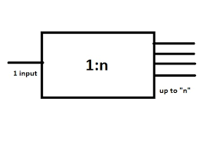
Demultiplexer (DEMUX)
DEMUX is exactly opposite to MUX. DEMUX always has single input and multiple outputs unlike MUX.
It can be called as Data Distributor.
Size of DEMUX = 1 x 2^{n} where n is select inputs.

Slide 39
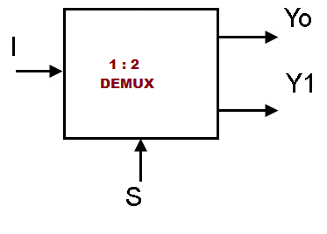
1:2 DEMUX
No of input = 1
No of outputs = 2
Size of DEMUX = 1 x 2¹
No of select input = 1
S | Y0 | Y1
0 | I | 0
1 | 0 | I
Y0 = S’.I
Y1 = S.I

Slide 40
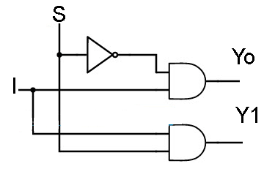
1:2 DEMUX
Y0 = S’I
Y1 = SI

Slide 41
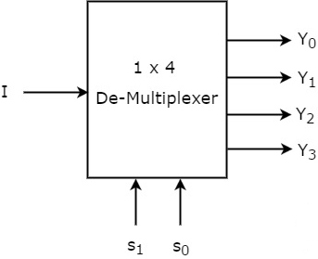
1:4 DEMUX
No of input = 1
No of outputs = 4
Size of DEMUX = 1 x 2²
No of select inputs = 2
S₁ | S₀ | Y0 | Y1 | Y2 | Y3
0 | 0 | I | 0 | 0 | 0
0 | 1 | 0 | I | 0 | 0
1 | 0 | 0 | 0 | I | 0
1 | 1 | 0 | 0 | 0 | I
Y0 = s’₁.s’₀.I Y2 = s1.s0’.I
Y1 = s₁’.s₀.I Y3 = s₁.s₀.I

Slide 42
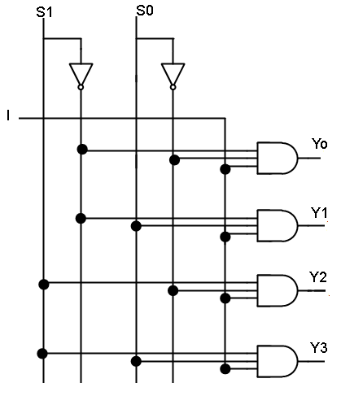
1:4 DEMUX
Y0 = s’₁.s’₀.I Y2 = s1.s0’.I
Y1 = s₁’.s₀.I Y3 = s₁.s₀.I

Slide 43
1:8 DEMUX
No of input = 1 (I)
No of outputs = 8
Size of DEMUX = 1 x 2³
No of select inputs = 3
s2 | s1 | s0 | y0 | y1 | y2 | y3 | y4 | y5 | y6 | Y7
0 | 0 | 0 | I | 0 | 0 | 0 | 0 | 0 | 0 | 0
0 | 0 | 1 | 0 | I | 0 | 0 | 0 | 0 | 0 | 0
0 | 1 | 0 | 0 | 0 | I | 0 | 0 | 0 | 0 | 0
0 | 1 | 1 | 0 | 0 | 0 | I | 0 | 0 | 0 | 0
1 | 0 | 0 | 0 | 0 | 0 | 0 | I | o | o | 0
1 | 0 | 1 | 0 | o | o | o | o | I | o | 0
1 | 1 | 0 | 0 | o | o | o | o | o | I | 0
1 | 1 | 1 | 0 | o | o | o | o | o | o | I

Slide 44
Decoder
A decoder is a combinational circuit.
A decoder accepts a set of inputs that represents a binary number and activates only that output corresponding to the input number. All other outputs remain inactive. • Fig. 1 shows the block diagram of decoder with ‘N’ inputs and ‘M’ outputs.
There are ‘n’ inputs, for each of these input combination only one output will be HIGH (active) all other outputs are LOW.
The numbers of output is ‘2^{n}’.
So, size of Decoder = n x 2^{n}

Slide 45
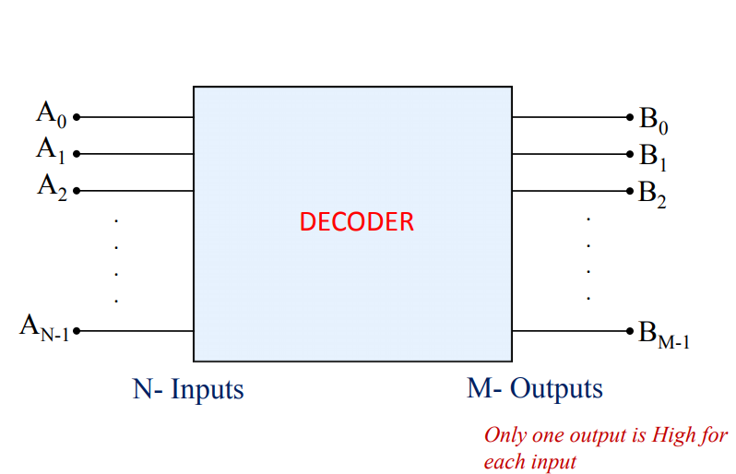
Decoder

Slide 46
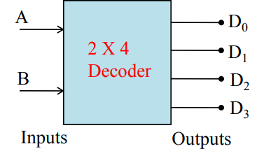
2x4 Decoder
No. of inputs = 2 (A,B)
No. of Outputs : 2² = 4, (D0 , D1 , D2 and D3)
A | B | D0 | D1 | D2 | D3
0 | 0 | 1 | 0 | 0 | 0
0 | 1 | 0 | 1 | 0 | 0
1 | 0 | 0 | 0 | 1 | 0
1 | 1 | 0 | 0 | 0 | 1
D0 = A’B’
D1 = A’B
D2 = AB’
D3 = AB

Slide 47
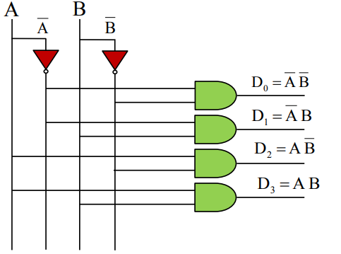
2x4 Decoder
D0 = A’B’ D1 = A’B
D2 = AB’ D3 = AB

Slide 48
3x8 Decoder
No. of inputs = 3 (A,B,C)
No. of Outputs : 2³ = 8, (D0, D1, D2, D3, D4, D5, D6, D7)
A | B | C | D0 | D1 | D2 | D3 | D4 | D5 | D6 | D7
0 | 0 | 0 | 1 | 0 | 0 | 0 | 0 | 0 | 0 | 0
0 | 0 | 1 | 0 | 1 | 0 | 0 | 0 | 0 | 0 | 0
0 | 1 | 0 | 0 | 0 | 1 | 0 | 0 | 0 | 0 | 0
0 | 1 | 1 | 0 | 0 | 0 | 1 | 0 | 0 | 0 | 0
1 | 0 | 0 | 0 | 0 | 0 | 0 | 1 | 0 | 0 | 0
1 | 0 | 1 | 0 | 0 | 0 | 0 | 0 | 1 | 0 | 0
1 | 1 | 0 | 0 | 0 | 0 | 0 | 0 | 0 | 1 | 0
1 | 1 | 1 | 0 | 0 | 0 | 0 | 0 | 0 | 0 | 1
D0 = A’B’C’ D1 = A’B’C D2 = A’BC’ D3 = AB’C
D4 = AB’C’ D5 = AB’C D6 = ABC’ D7 = ABC

Slide 49
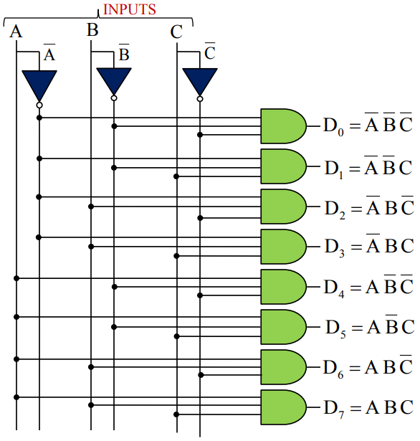
3x8 Decoder

Slide 50
1x2 Decoder
A | D0 | D1
0 | 1 | 0
1 | 0 | 1
D0 = A’
D1 = A

Slide 51
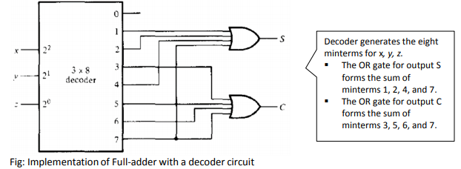
Implementation of Boolean Function using Decoder
We can implement any Boolean function using decoder and OR gates.
Implement the Full adder circuit using a Decoder.
S(a,b,c) = ∑(1,2,4,7)
C(a,b,c)= ∑(3,5,6,7)
In decoder; no. of inputs = 3 and no. if outputs = 2³ = 8
size = 3 x 8

Slide 52
Implementation of Boolean Function using Decoder
1. Realize F(A,B,C,D) = ∑(0,1,3,5,7,8,11,13,15) using decoder.
In decoder;
No of inputs = 4 and outputs = 16
Size = 4 x 16
2. Realize F(A,B,C,D) = ∑(0,1,3,5,7,8,11,13,15) using decoder and NOR gate.

Slide 53
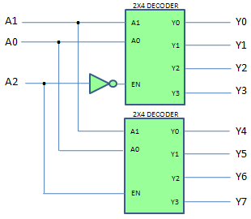
Decoder
Design 3x8 Decoder using two 2x4 Decoder.
When A2 = 0 ,
En = 1 in top decoder,
it is in operation,
En = 0 in Bottom decoder
and it is not
in operation.
Similarly, When A2 = 1 ,
En = 1 in bottom decoder,
it is in operation,
En = 0 in top decoder
and it is not
in operation.

Slide 54
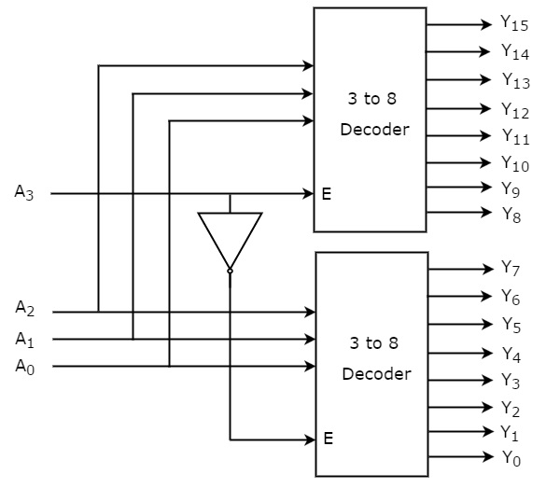
Decoder
Design 4x16 Decoder using two 3x8 Decoder.

Slide 55
Encoder
An Encoder is a combinational logic circuit.
• It performs the inverse operation of Decoder.
• The opposite process of decoding is known as Encoding.
• An Encoder has ‘M’ input lines, only one of which is activated at a given time, and produces an N-bit output code, depending on which input is activated.
• Size of Encoder = 2^{n} x n

Slide 56
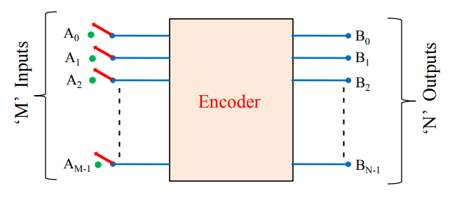
Encoder

Slide 57
8x3 Encoder (2^{n} x n)
No. of inputs = 2³ = 8; (D0, D1, D2, D3, D4, D5, D6, D7)
No. of Outputs = 3 ; (x,y,z)
D0 | D1 | D2 | D3 | D4 | D5 | D6 | D7 | x | y | z
1 | 0 | 0 | 0 | 0 | 0 | 0 | 0 | 0 | 0 | 0
0 | 1 | 0 | 0 | 0 | 0 | 0 | 0 | 0 | 0 | 1
0 | 0 | 1 | 0 | 0 | 0 | 0 | 0 | 0 | 1 | 0
0 | 0 | 0 | 1 | 0 | 0 | 0 | 0 | 0 | 1 | 1
0 | 0 | 0 | 0 | 1 | 0 | 0 | 0 | 1 | 0 | 0
0 | 0 | 0 | 0 | 0 | 1 | 0 | 0 | 1 | 0 | 1
0 | 0 | 0 | 0 | 0 | 0 | 1 | 0 | 1 | 1 | 0
0 | 0 | 0 | 0 | 0 | 0 | 0 | 1 | 1 | 1 | 1
x = D4 + D5 + D6 + D7
y = D2 + D3 + D6 + D7
z = D1 + D3 + D5 + D7

Slide 58
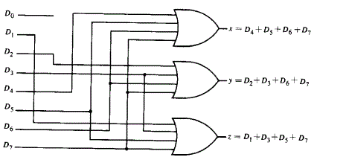
8x3 Encoder
x = D4 + D5 + D6 + D7
y = D2 + D3 + D6 + D7
z = D1 + D3 + D5 + D7

Slide 59
4x2 Encoder
No. of inputs = 4; (D0, D1, D3 , D4)
No. of Outputs = 2; (x,y)
D0 | D1 | D2 | D3 | x | y
1 | 0 | 0 | 0 | 0 | 0
0 | 1 | 0 | 0 | 0 | 1
0 | 0 | 1 | 0 | 1 | 0
0 | 0 | 0 | 1 | 1 | 1
X = D2 + D3
Y = D1 + D3

Slide 60
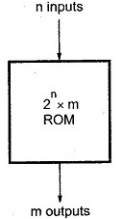
ROM
ROM is a combinational circuit.
It is used as storage medium in electronic devices.
It includes both the decoder and OR gates within a single IC package.
Size of the ROM
2^{n} x m → 2^{n} words of m bits can be stored.
Where; ‘2^{n}’ is number of words.
‘m’ is number of bit per word.
If 2^{n} x m is the size of ROM, n is the
input of Decoder used and m is the
number of OR gates.
Each combination of i/p and o/p is called
address and word respectively.

Slide 61
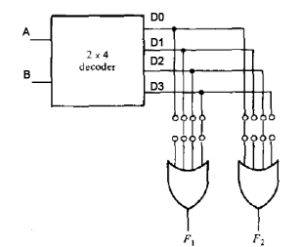
Implementation of Boolean Function using ROM
Implement F1(A,B)= ∑(1,2,3) and F2(A,B)= ∑(0,2) using ROM.
Size of the ROM = 2² x 2
Size of the decoder = 2 x 4
Number of OR gates = 2

Slide 62
Implementation of Boolean Function using ROM
Implement Full adder circuit using ROM.
S(a,b,c) = ∑(1,2,4,7)
C(a,b,c) = ∑(3,5,6,7)
Size of the ROM = 2³ x 2
Size of the decoder = 3 x 8
Number of OR gates = 2

Slide 63
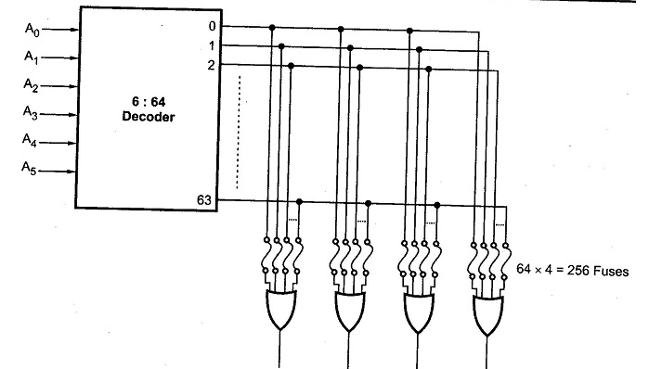
Implementation of Boolean Function using ROM
If we have to design a ROM having a decoder of size 6 x 64 :

Slide 64
Types of ROM
PROM
EPROM
EEPROM
Flash Memory

Slide 65
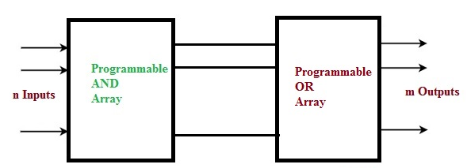
Programmable Logic Array(PLA)
PLA is similar to ROM in concept. It is a Programmable logic device
with programmable AND gates followed by programmable OR gates.
Here, Decoder is replaced by a group of AND gates which can be programmed.
A m x n PLA has ‘m’ buffer Inverter.
Number of AND gates = number of minterms (excluding repeated minterms)
Number of OR gates = n

Slide 66
Implementation of Boolean Function using PLA
Implement F1(A,B,C)= ∑(3,5,6,7) and F2(A,B,C)= ∑(0,2,4,7) using PLA.
No of inputs = 3
No of outputs = 2
A 3 x 2 PLA has ‘3’ buffer Inverter.
Number of AND gates = number of minterms (excluding repeated minterms)
Number of OR gates = 2

Slide 67
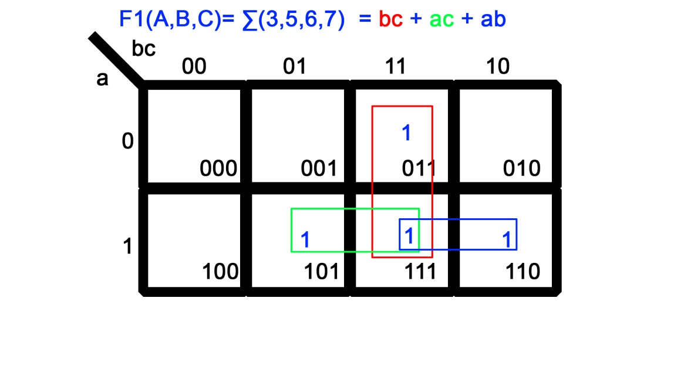
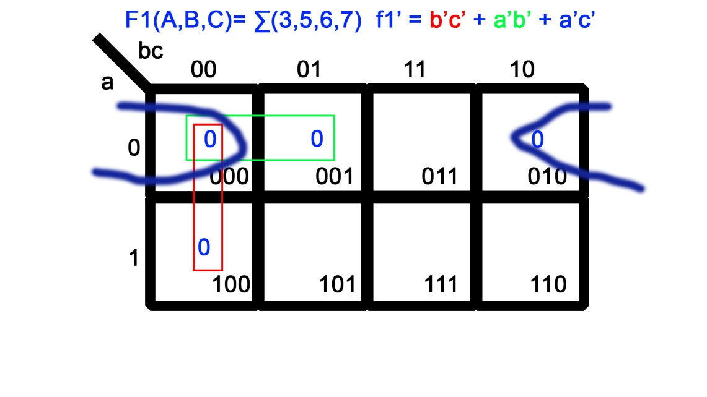
Implementation of Boolean Function using PLA
Implement F1(A,B,C)= ∑(3,5,6,7) and F2(A,B,C)= ∑(0,2,4,7) using PLA.
Similarly,
F2 = A‘C’ + B‘C’+ ABC
F2’ = A’C + B’C + ABC’

Slide 68
Implementation of Boolean Function using PLA
Implement F1(A,B,C)= ∑(3,5,6,7) and F2(A,B,C)= ∑(0,2,4,7) using PLA.
F1 = AB + AC + BC
F1’ = A’B’ + B’C’ + A’C’
F2 = A‘C’ + B‘C’+ ABC
F2’ = A’C + B’C + ABC’
F1 F2 = 6 terms
F1’ F2’ = 6 terms
F1’ F2 = 4 terms So, F1’ F2 is selected.
F1 F2’ = 6 terms

Slide 69
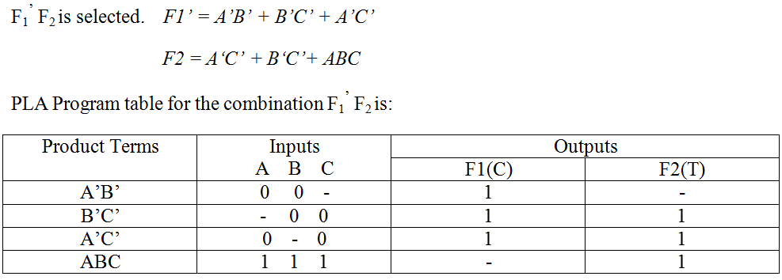
Implementation of Boolean Function using PLA
Implement F1(A,B,C)= ∑(3,5,6,7) and F2(A,B,C)= ∑(0,2,4,7) using PLA.

Slide 70
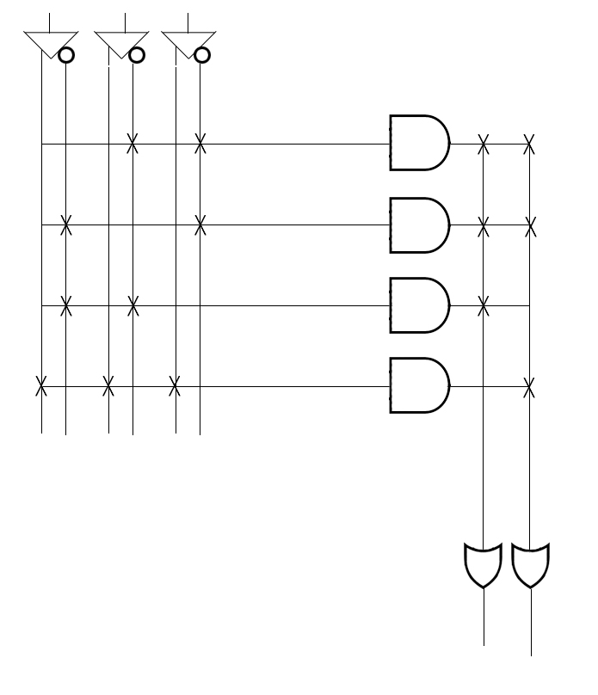
Implementation of Boolean Function using PLA
Implement F1(A,B,C)= ∑(3,5,6,7) and F2(A,B,C)= ∑(0,2,4,7) using PLA.
A B C
B’C’
A’C’
A’B’
ABC
F1’ = A’B’ + B’C’ + A’C’
F2 = A‘C’ + B‘C’+ ABC
F1’
F2

Slide 71
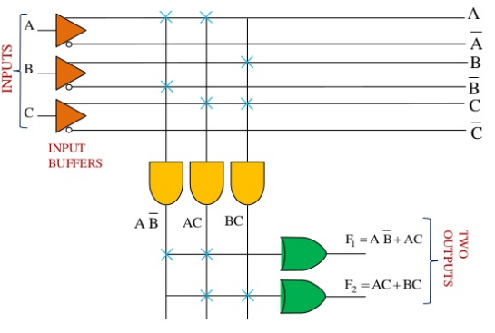
Implementation of Boolean Function using PLA
Implement F1(A,B,C)= ∑(4,5,7) and F2(A,B,C)= ∑(3,5,7) using PLA.
Since, F1 F2 is selected;
F1 = AB’+AC
F2 = BC + AC

